Slide 1

Tanzania Water Wells Project Prediction Analysis
Presented by: Vivian King’asia
Last updated: 31st July, 2022

Slide 2
Project Scope
The primary goal is to develop a model that will predict functionality of water pumps.
Stakeholders in this project are NGOs.
Recall is our most important metric.
NGOs need identify pumps that need maintenance, which need to be donated and which ones need repairs.

Slide 3
Objectives
To be able to predict which water pump systems are functional [class 1]
and non_functional [class 0].
To determine what features can be improved to ensure high functionality or better conditions of water pumps.

Slide 4
Key Findings Top Ten Important Features[Descending Order]
Level of Importance
Waterpoint type(other)
Quantity(dry)
Extraction_type(other)
Waterpoint type(communal standpipe multiple)
Quantity (enough)
Amount tsh
Management vwc
Source-spring
Quality(milky)
Public Meeting

Slide 5
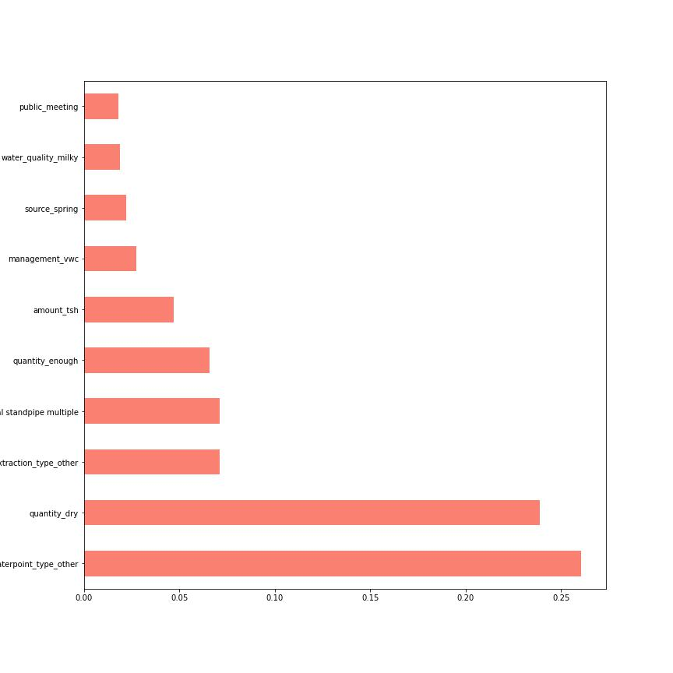
Key Findings Top Ten Most Important Features

Slide 6
Key Findings Top 5 Funders and Installers of Water Pumps (From the Largest to Smallest)
TOP FUNDERS
Government of Tanzania
2. Unknown Funders(Missing Information)
3. Danida
4. Hesawa
5.RWssp

Slide 7
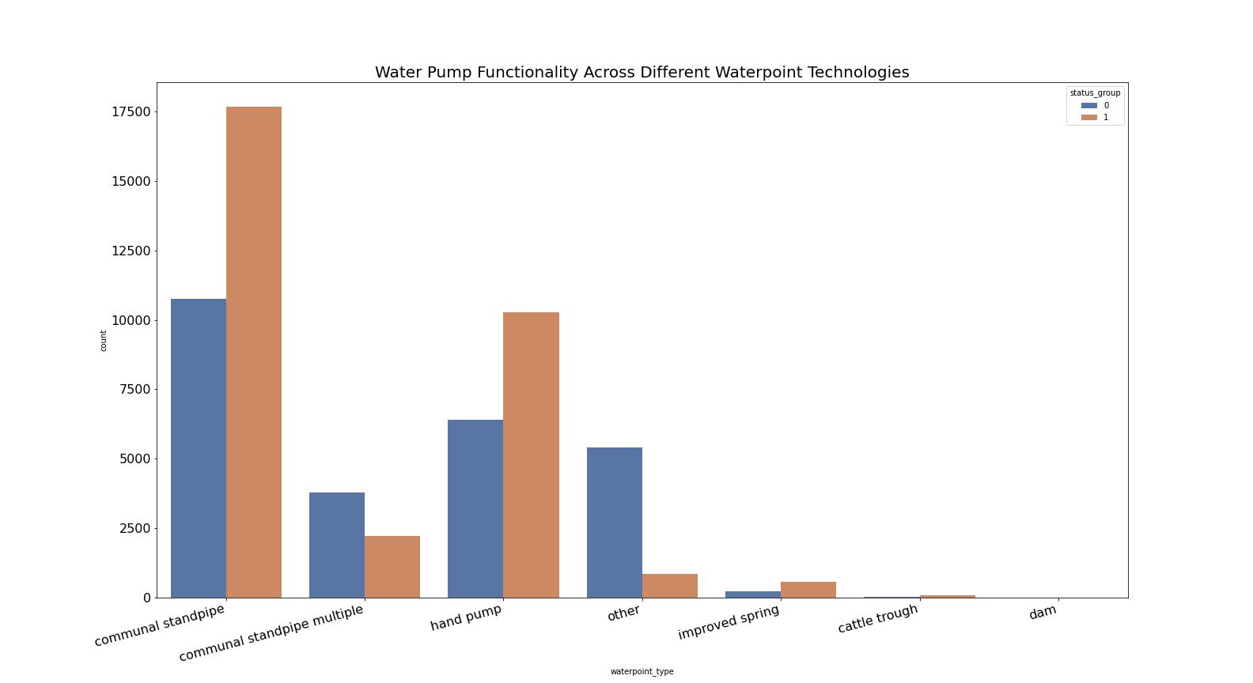
Key Findings Functionality of Water Pumps Across Water_point Types

Slide 8
Key Findings
Functional | Non-Functional
Communal Standpipes | Communal Standpipe(multiple)
Handpipes | Waterpoint(other)
Improved Spring
Cattle Trough

Slide 9
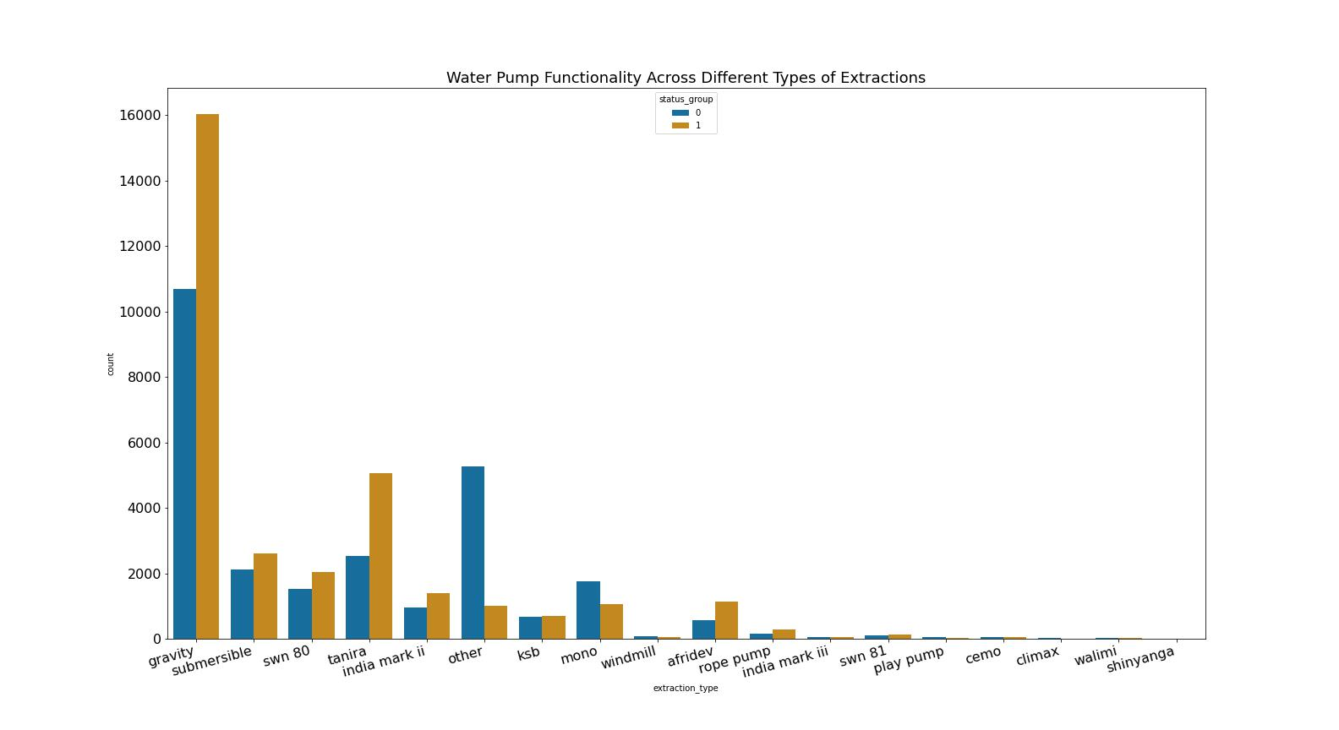
Functionality of Water Pumps Across Extraction Types

Slide 10
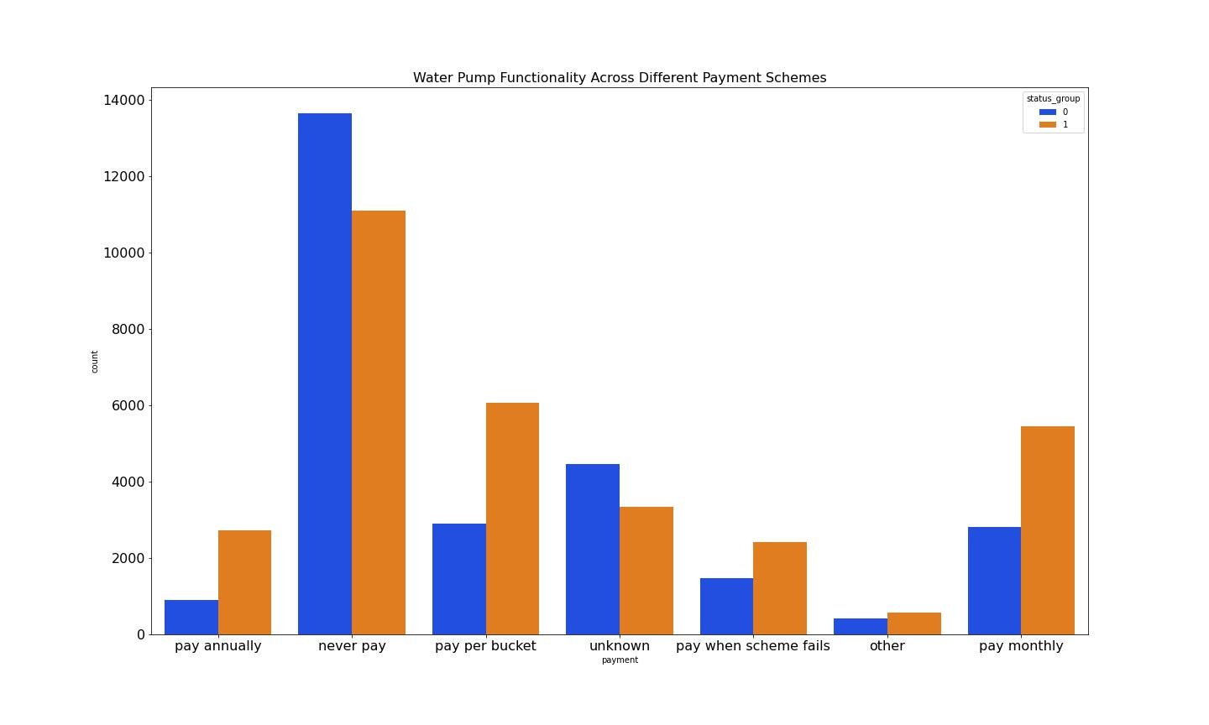
Functionality of Water Pumps Across Payment Schemes

Slide 11
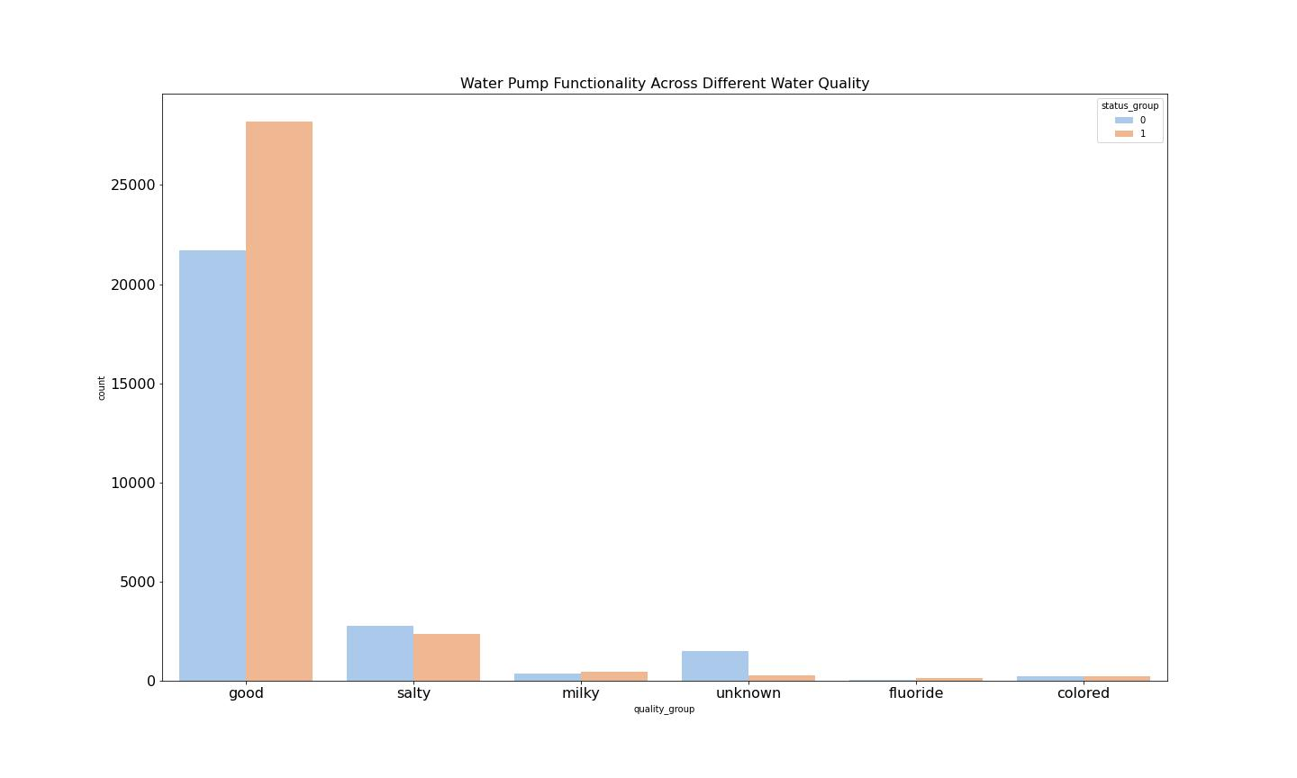
Functionality of Water Pumps Across Water Quality

Slide 12
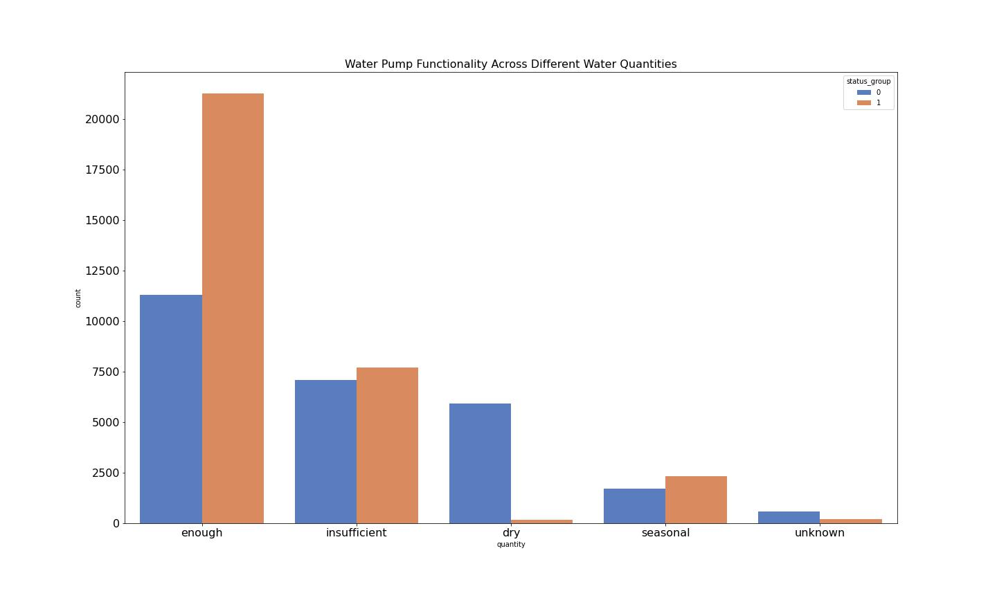
Functionality of Water Pumps Across Water Quantity

Slide 13
Conclusion
The accuracy of 73% tells us that our model will assign the correct label; functional as 1 or non functional as 0 73% of the time.
Our recall of 89% means that our model is able to identify 89% of the true positives 73% of the time.
Results showed that type of waterpoint technology, type of extraction and amount paid for water affects the failure rates of these waterpoint types.

Slide 14
Recommendations
NGOs should invest in better water pump technologies such as communal waterpoints and handpumps.
Areas which are drier lead to nonfunctional pumps perhaps due to low usage
This analysis was converted to a binary classification and hence there is a level of predictive error when it comes to distinguishing between pumps that are functional but need repair and those that are completely non_functional.

